Slide 1
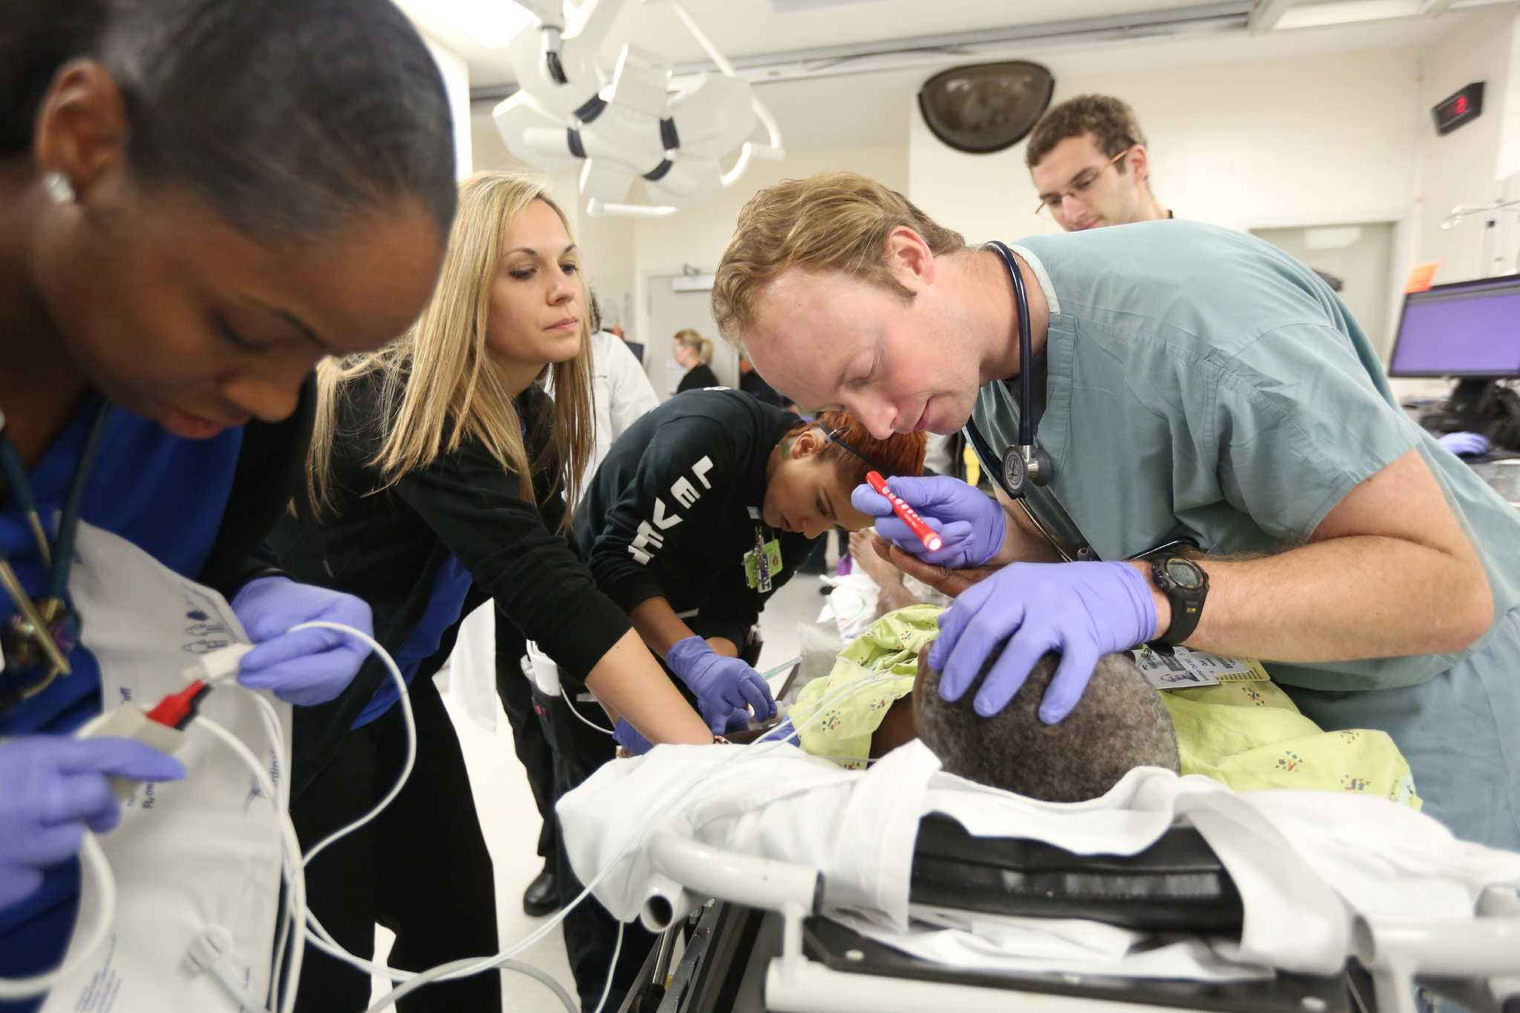
ABC of Trauma

Slide 2
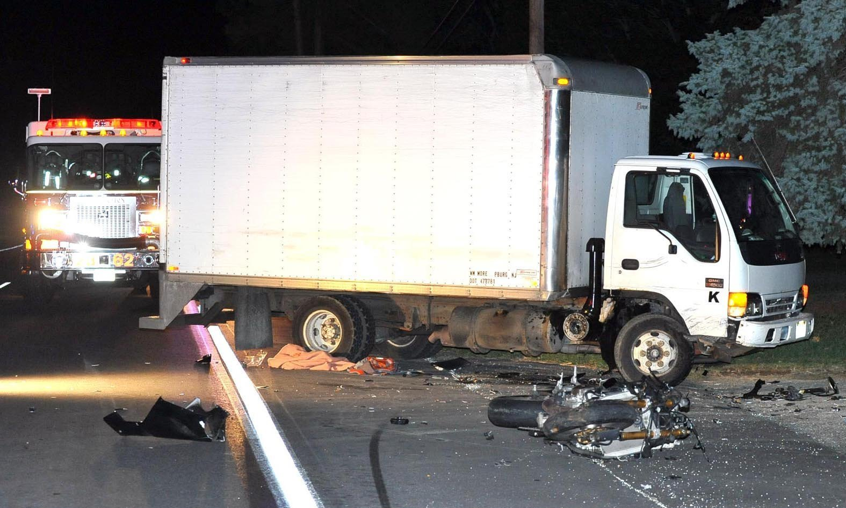
Case Scenario :
54 year old male motorbike rider brought to ETU following a crash head on to a lorry 10 minutes back.
Patient was unresponsive.
Bleeding noted at scalp.

Slide 3
To Know:
Primary Survey
Resuscitation
Adjuncts to primary survey and resuscitation

Slide 4
Preparation for trauma:
1. Prehospital phase
Airway maintenance
control of external bleeding and shock
immobilization
immediate transfer to closest hospital/trauma center
2. Hospital phase
Resuscitation area
functioning, organized, tested, accessible equipment and monitors
warmed infusion fluids, medications
Summon additional medical assistance
Laboratory and radiology
Specialized transfer arrangements

Slide 5
Primary Survey
Rapid and efficient assessment of vital functions
Identifying the life threatening condition
Always adhere to the sequence:
Airway maintenance with cervical spine protection
Breathing and Ventilation
Circulation with haemorrhage control
Disabilty : Neurologic status
Exposure / Environmental control:
Completely undress the patient, but prevent hypothermia

Slide 6
Primary Survey
What is a quick, simple way to assess a patient in 10 seconds ?
Ask patient’s name, what happened?
Appropriate response +
- no major airway compromise
- breathing is not severely compromised
- No major decrease in level of consciousness
Failure to respond
- Abnormalities in A, B or C
- need urgent assessment and management

Slide 7
Primary Survey
Airway maintenance with cervical spine protection
Ascertain airway patency first
Suctioning and inspection for foreign bodies
Facial, mandibular or tracheal/ laryngeal fractures
Chin-lift or jaw-thrust maneuver
Severe head injury with altered level of consciousness, GCS 8 or less needs definitive airway
Cuffed, secured ET tube

Slide 8
Primary Survey
Prevent excessive movement of cervical spine
Should not hyper-extend, hyper-flex or rotate head and neck
Appropriate cervical spine immobilization device – Hard collar
Inline immobilization technique (if temporary removal of stabilizing device) – manual stabilization
Assume a cervical spine injury in
Blunt multisystem trauma
Altered level of consciousness
Blunt injury above clavicle

Slide 9
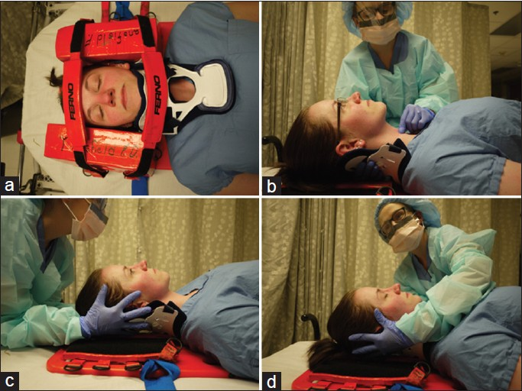

Slide 10
Primary Survey
Frequent re-evaluation of airway patency is essential
Difficulties/ pitfalls
Equipment failure – laryngoscope light
Short neck, obesity
Unknown laryngeal fracture
Incomplete upper airway transection

Slide 11
Primary Survey
Breathing and ventilation
Adequate gas exchange, oxygenation and CO2 elimination
Adequate function of the lungs, chest wall and diaphragm
Adequate nech and chest exposure
Jugular venous distension
Position of trachea
Chest wall excursion, inspection, palpation, percussion
Auscultation of lungs

Slide 12
Primary Survey
Breathing and ventilation
Immediate attention – severe impairment of ventilation
Tension pneumothorax
Flail chest with pulmonary contusion
Massive haemothorax
Open pneumothorax
Less impairment
Simple pneumothorax
Simple haemothorax
Rib fractures
Minor pulmonary contusions

Slide 13
Primary Survey
Breathing and ventilation
Difficulties/ pitfalls
Difficult differentiation – ventilation/airway problem
Intubation with vigorous bag-mask ventilation – further deterioration if pneumothorax/tension pneumothorax

Slide 14
Primary Survey
Circulation with haemorrhage control
Circulatory compromise
Blood volume loss
Reduced cardiac output
Bleeding
Blood volume and cardiac output
Haemorrhage – predominant cause of preventable death
Hypotension – hypovolaemia until proven otherwise
Pulse – quality, rate, regularity
Level of consciousness – reduced cerebral perfusion
Pallor
Rapid, thready pulse – hypovolaemia
Irregular pulse – potential cardiac dysfunction
Absent central pulse – immediate resuscitation

Slide 15
Primary Survey
Circulation with haemorrhage control
Bleeding
Identify source of bleeding – internal/ external
External
Direct manual pressure
Tourniquets – risk of ischaemic injury
Haemostats – can damage nerves and veins
Internal
Chest, abdomen, retroperitoneum, pelvis, long bones
Source identification? – physical examination, imaging
Chest x-ray, Pelvic x-ray, FAST
Chest decompression, Pelvic binders, Splints or surgical intervension

Slide 16
Primary Survey
Circulation with haemorrhage control
Difficulties/ pitfalls
Elderly
Limited ability to increase heart rate
BP has little correlation with cardiac output
Anticoagulation treatment – increase blood loss
Children
Abundant physiological reserve – few signs even after sever volume depletion
Athletes
- no usual level of tachycardia with blood loss

Slide 17
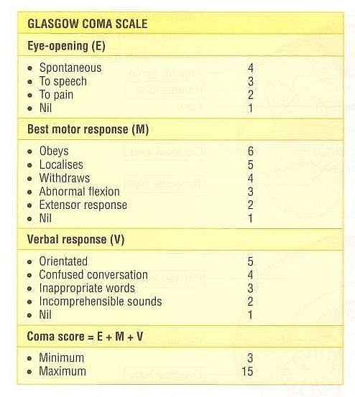
Primary Survey
Disability ( Neurologic evaluation)
At the end of primary survey
Level of consciousness
Pupillary size and reaction
Lateralizing signs
Spinal cord injury level
GCS

Slide 18
Primary Survey
Disability ( Neurologic evaluation)
Altered level of consciousness/ low GCS ?
Low oxygenation, ventilation
Low cerebral perfusion
Hypoglycaemia
Alcohol
Narcotics and other drugs
If all excluded
Traumatic central nervous system origin until proven otherwise.

Slide 19
Primary Survey
Exposure and Environmental control
Complete undressing
Thorough examination and assessment
Cover with warm blankets, external warming device – prevent hypothermia
Warm fluids, warm environment
The patient’s body temperature is more important than the comfort of the healthcare providers.

Slide 20
Resuscitation
Resuscitation and management of life threatening injury – once identified
- Resuscitation Simultaneously with evaluation

Slide 21
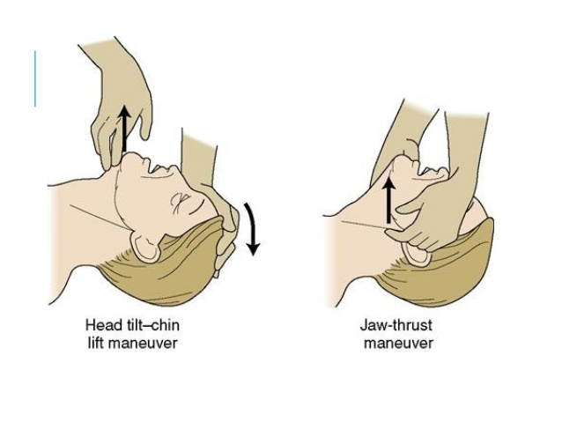
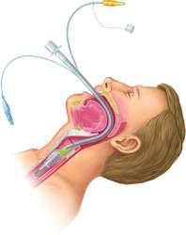
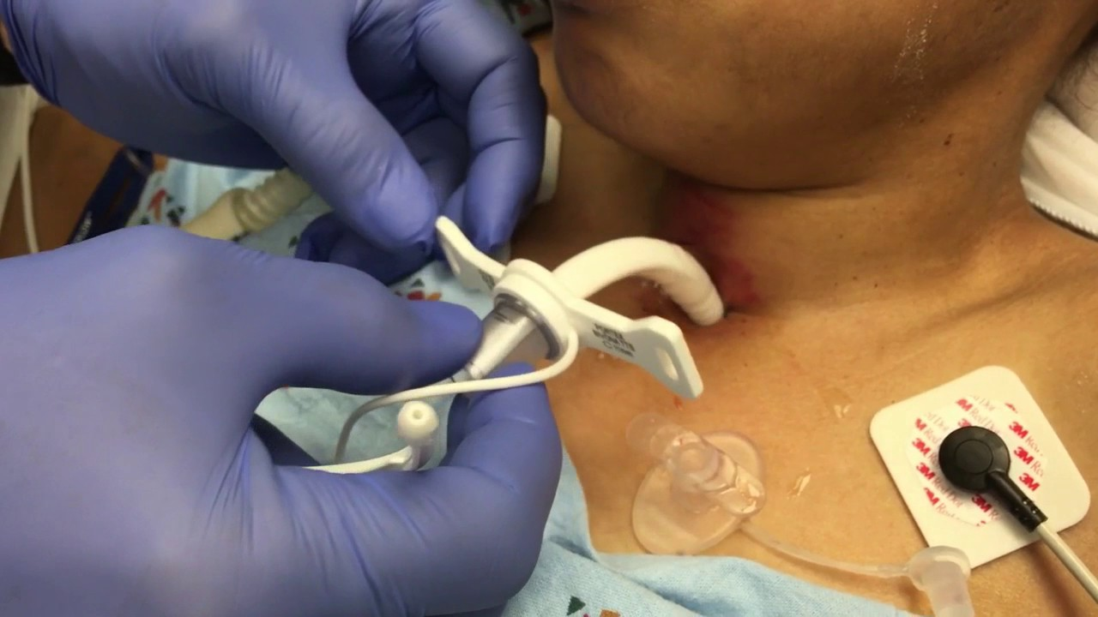
Resuscitation
Airway
jaw-thrust or chin-lift
Temporary oropharyngeal airway
Definite airway – intubation – ET tube
Surgical airway/ tracheostomy – if intubation is contraindicated or unable to be achieved

Slide 22
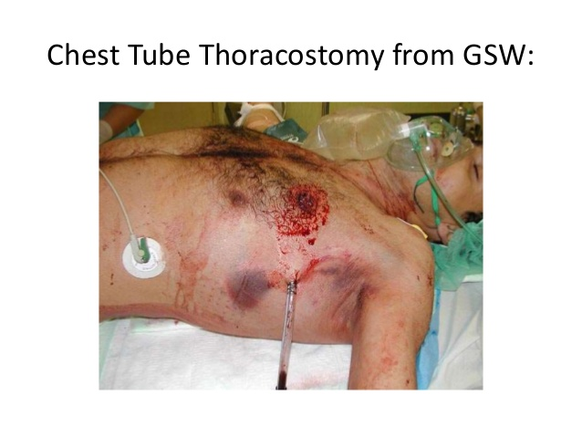
Resuscitation
Breathing, Ventilation and oxygenation
Supplemental oxygen
Pulse oximeter
Chest decompression –IC tube insertion

Slide 23
Resuscitation
Circulation and haemorrhage control
Bleeding control with appropriate replacement of intravascular volume
Minimum two large bore IV cannula
Upper extremity peripheral access preferred
Others – Central venous line, venous cut-downs
Blood for cross matching, basic haematological studies
ABG
IV fluids with crystalloids
Warm fluids (37- 40 C, 98.6–104 F)
Prevent hypothermia
Blood transfusion
Definite control of haemorrhage – Surgery, angio-embolization

Slide 24
Adjuncts to Primary Survey and Resuscitation
ECG monitoring
Unexplained tachycardia, AF, ST segment changes : blunt cardiac injuries
Pulseless electrical activity : cardiac tamponade , tension pneumothorax, hypovolaemia
Bradycardia/aberrant conduction/ premature beats : hypoxia, hypo perfusion
Urinary catheters
For UOP monitoring
Contraindicated in suspected urethral injury
Blood at urethral meatus
Perineal ecchymosis
High-riding or nonpalpable prostate
Gastric catheters (NG tube)
Reduce stomach distention and Prevent aspiration
Assess upper GI haemorrhage
In suspected cribriform plate fracture – oro-gastric tube – to prevent intracranial passage

Slide 25
Adjuncts to Primary Survey and Resuscitation
Other monitoring – Periodic re-evaluation
Pulse rate
BP
RR
Pulse oximetry
ABG levels
Body temperature
Urine output
X-ray examination, Non-contrast CT and other diagnostic studies
CXR (PA)
X-ray pelvis (AP), X-ray cervical spines, thoracolumbar spines, lumbosacral spines
X-ray skull
X-ray extremities
NCCT brain
FAST – Focused Assessment Sonography in Trauma

Slide 26
Consider need for patient transfer
Secondary survey

Slide 27
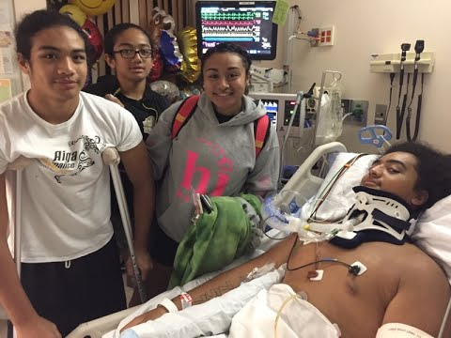
Thank you

